Slide 1
PDF Active Reading Assistant Review Class Presentation and Demo
CS 422 Group 7
Ryan Helms, William Qiu, Nikhar Ramlakhan, Abie Safdie, Caleb Sutherland
Notes:
Presentation Outline
There are basically seven topic areas, as follows. Please try to spend roughly one minute per topic area unless all of the groups did the same thing for that topic area:
A. Explain what you did
Provide a brief description of the system from the user's perspective, such as the Concept of Operations. However, if every group developed the same system (as in fulfilled the same requirements), do not spend more than 10 seconds on this.
Show a demo of the system as a user would use the system to accomplish real-world tasks. Focus on the functionality necessary to accomplish real-world tasks. You do not need to show every feature. Please do not show a user logging in with a username and password; this is not an interesting feature to show in a demo, and not a good use of time in a presentation.
Briefly described the technologies used to build the system. If every group used basically the same technologies, do not spend more than 10 seconds on this.
B. Explain how you did it.
How you established the system requirements. List (a) existing systems (and technology) that you looked at and what you learned by looking at each, (b) who you interviewed, how you recruited your interviewees, and what you learned from each interview, and (c) other sources that you used, other than your guesswork, to establish system requirements • State at least one thing that your group learned about requirements analysis and specification.
• Skip this step if you did not develop the system requirements (such as if they were assigned).
How you translated the system requirements into a software design (not a user interface design). Describe the process that you used to do this translation. This should include a few diagrams that communicate what is the final design of the software, not from the user's perspective but instead from the programmer's. If you can show early design ideas, and explain how and why these early ideas evolved, that would be very good. Keep in mind that this is not the design of the user interface, but rather of the software components and how they interact. • State at least one thing that your group learned about software design.
How you integrated and tested your systems. What was the process? How did it go? What went well, and what did not go well? If you conducted any user observation studies, describe them briefly here. • State at least one thing that your group learned about software testing.
How was the team managed? How was the team experience? What went well and what did not go well? • State at least three things that your group learned about working on a team.

Slide 2
Project and Technology Overview
Project Overview
ARA facilitates the SQ3R reading method, allowing users to view PDFs, take notes, and store them in a database for cross-device access.
Key features: PDF viewing, note-taking, database integration and multiple user support.
Technology Overview
Python: Backend logic and GUI development.
Tkinter: GUI library for creating the user interface.
PyMuPDF: PDF handling and integration into the GUI.

Slide 3
ARA in Action:
Live demonstration of our system in action.
Setting up and connecting to a server.
Configuring the MySQL server as an administrator and including connection setup.
Navigating the PDF selection screen.
Showcasing the PDF annotation functions.

Slide 4
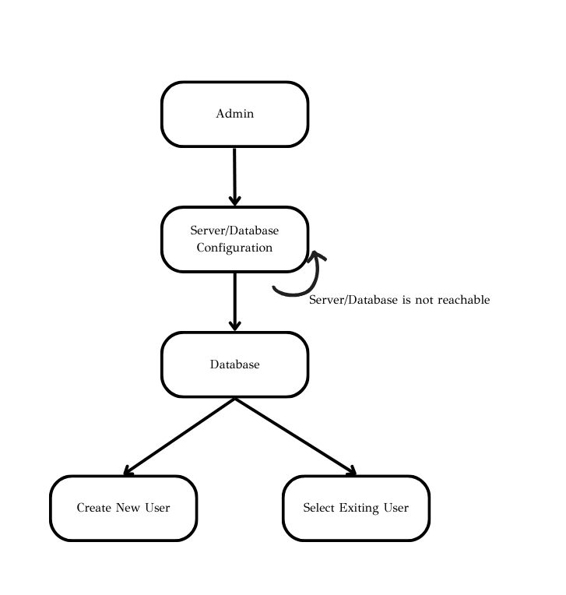
Translating SRS into SDS
Understand the SRS
Define the software architecture
Breakdown the software modules
Detailed Design
Interface Design

Slide 5
Testing
Each person tests their own modules and then works together to integrate them.
Overall testing went well but there were challenges.
Some features were easier to integrate than others. Adding new elements to the GUI was much less involved than connecting the database.
At times it can be difficult to determine whose end the problem is on.

Slide 6
Teamwork – Benefits and Struggles
Benefits
Divide and Conquer!
Experience working in a team
Troubleshooting
Struggles
Navigating GitHub with multiple users
Miscommunication
Project Management / Assigning Tasks

Slide 7
Thank You!
Notes:
Presentation Outline
There are basically seven topic areas, as follows. Please try to spend roughly one minute per topic area unless all of the groups did the same thing for that topic area:
A. Explain what you did
Provide a brief description of the system from the user's perspective, such as the Concept of Operations. However, if every group developed the same system (as in fulfilled the same requirements), do not spend more than 10 seconds on this.
Show a demo of the system as a user would use the system to accomplish real-world tasks. Focus on the functionality necessary to accomplish real-world tasks. You do not need to show every feature. Please do not show a user logging in with a username and password; this is not an interesting feature to show in a demo, and not a good use of time in a presentation.
Briefly described the technologies used to build the system. If every group used basically the same technologies, do not spend more than 10 seconds on this.
B. Explain how you did it.
How you established the system requirements. List (a) existing systems (and technology) that you looked at and what you learned by looking at each, (b) who you interviewed, how you recruited your interviewees, and what you learned from each interview, and (c) other sources that you used, other than your guesswork, to establish system requirements • State at least one thing that your group learned about requirements analysis and specification.
• Skip this step if you did not develop the system requirements (such as if they were assigned).
How you translated the system requirements into a software design (not a user interface design). Describe the process that you used to do this translation. This should include a few diagrams that communicate what is the final design of the software, not from the user's perspective but instead from the programmer's. If you can show early design ideas, and explain how and why these early ideas evolved, that would be very good. Keep in mind that this is not the design of the user interface, but rather of the software components and how they interact. • State at least one thing that your group learned about software design.
How you integrated and tested your systems. What was the process? How did it go? What went well, and what did not go well? If you conducted any user observation studies, describe them briefly here. • State at least one thing that your group learned about software testing.
How was the team managed? How was the team experience? What went well and what did not go well? • State at least three things that your group learned about working on a team.

